Slide 1
CSE 331
Automata and computability
Lecture 3
Summer 2026

Slide 2
Today's learning goals Sipser Ch 1.1, 1.2
Review what it means for a set to be closed under an operation.
Define the regular operations on languages
Prove closure properties of the class of regular languages

Slide 3

Building DFA
Remember
States are our only (computer) memory.
Design and pick states with specific roles / tasks in mind.
"Have not seen any of desired pattern yet"
"Trap state"

Slide 4
A useful (optional) bit of terminology
When is a string accepted by a DFA?
Computation of M on w: where do we land when start at q₀ and read each symbol of w one-at-a time?
δ*( q, w ) =
Recursively defined function

Slide 5
Regular languages Sipser p. 35 Def 1.5
For DFA M over the alphabet Σ
  For each string w over Σ, M either accepts w or rejects w
  The language recognized by M is the set of strings M accepts
  The language of M is the set of strings M accepts
  L(M) = { w | w is a string over Σ and M accepts w}
Definition: A language is regular iff there is some finite automaton that recognizes exactly it.

Slide 6
Regular languages: bounds?
Is every finite language regular?
No: some finite languages are regular, and some are not.
No: there are no finite regular languages.
Yes: every finite language is regular.
I don't know.

Slide 7
Building DFA
New strategy
Express L in terms of simpler languages – use them as building blocks.
Example L = { w | w does not contain the substring baba }
= the complement of the set
{w | w contains the substring baba}

Slide 8
Building DFA
DFA recognizing {w | w contains the substring baba}
DFA recognizing {w | w doesn't contain the substring baba}

Slide 9

Complementation
Theorem: If A is a regular language over {0,1}*, then so is its complement $\overline{A}$
aka "the class of regular languages is closed under complementation"

Slide 10
Closure of … under …
Z under addition.
Set of even ints under multiplication.
{0}* under concatenation.
Which of these is true?
The set of odd integers is closed under addition.
The set of positive integers is closed under subtraction.
The set of rational numbers is closed under multiplication.
The set of real numbers is closed under division.
I don't know.

Slide 11
Complementation
Theorem: If A is a regular language over {0,1}*, then so is its complement $\overline{A}$
aka "the class of regular languages is closed under complementation"

Slide 12
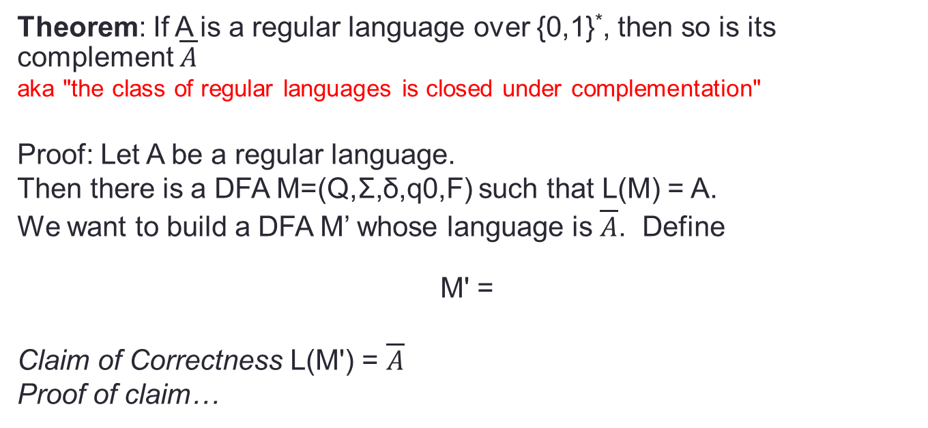
Complementation
Theorem: If A is a regular language over {0,1}*, then so is its complement $\overline{A}$
aka "the class of regular languages is closed under complementation"
Proof: Let A be a regular language.
Then there is a DFA M=(Q,Σ,δ,q0,F) such that L(M) = A.
We want to build a DFA M’ whose language is $\overline{A}$. Define
M' =
Claim of Correctness L(M') = $\overline{A}$
Proof of claim…
?

Slide 14
Why closure proofs?
General technique of proving a new language is regular
Stretch the power of the model
Puzzle!

Slide 15
The regular operations Sipser Def 1.23 p. 44
For A, B languages over same alphabet, define:
These are operations on sets!

Slide 16
Union Sipser Theorem 1.25 p. 45
Theorem: The class of regular languages over fixed alphabet Σ is closed under the union operation.
Proof:
What are we proving here?
For any set A, if A is regular then so is A U A.
For any sets A and B, if A U B is regular, then so is A.
For two DFAs M1 and M2, M1 U M2 is regular.
None of the above.
I don't know.

Slide 17
Union Sipser Theorem 1.25 p. 45
Theorem: The class of regular languages over fixed alphabet Σ is closed under the union operation.
Proof: Let A1, A2 be any two regular languages over Σ.
WTS that A1 U A2 is regular.
Goal: build a DFA that recognizes A1 U A2.

Slide 18
Union Sipser Theorem 1.25 p. 45
Goal: build a DFA that recognizes A1 U A2.
Strategy: use DFAs that recognize each of A1, A2.
M1
Input
Accept if
either (or both) accepts
M2
** HOW? **

Slide 19
Union Sipser Theorem 1.25 p. 45
Theorem: The class of regular languages over fixed alphabet Σ is closed under the union operation.
Proof: Let A1, A2 be any two regular languages over Σ.
Given M1 = (Q1,Σ,δ1,q1,F1) such that L(M1) = A1 and
M2 = (Q2,Σ,δ2,q2,F2) such that L(M2) = A2
WTS that A1 U A2 is regular.
Define M = (?,Σ,δ,?,?)

Slide 20
Union Sipser Theorem 1.25 p. 45
Theorem: The class of regular languages over fixed alphabet Σ is closed under the union operation.
Proof: Let A1, A2 be any two regular languages over Σ.
Given M1 = (Q1,Σ,δ1,q1,F1) such that L(M1) = A1 and
M2 = (Q2,Σ,δ2,q2,F2) such that L(M2) = A2 and
WTS that A1 U A2 is regular.
Define M = (Q1xQ2,Σ,δ,?,?)
Idea: run in parallel

Slide 21
Union Sipser Theorem 1.25 p. 45
Theorem: The class of regular languages over fixed alphabet Σ is closed under the union operation.
Proof: Let A1, A2 be any two regular languages over Σ.
Given M1 = (Q1,Σ,δ1,q1,F1) such that L(M1) = A1 and
M2 = (Q2,Σ,δ2,q2,F2) such that L(M2) = A2 and
WTS that A1 U A2 is regular.
Define M = (Q1xQ2,Σ,δ,?,?)
What should be the initial state of M?
q0
q1
q2
(q1,q2)
I don't know.

Slide 22
Union Sipser Theorem 1.25 p. 45
Theorem: The class of regular languages over fixed alphabet Σ is closed under the union operation.
Proof: Let A1, A2 be any two regular languages over Σ.
Given M1 = (Q1,Σ,δ1,q1,F1) such that L(M1) = A1 and
M2 = (Q2,Σ,δ2,q2,F2) such that L(M2) = A2 and
WTS that A1 U A2 is regular.
Define M = (Q1xQ2,Σ,δ,?,?)
When r is a state in M1, s is a state in M2, and x is in Σ, then δ( (r,s), x ) =
(r,s)
( δ(r,x), δ(s,x) )
( δ1(r,x), s )
( δ1(r,x), δ2(s,x) )
I don't know.

Slide 23
Union Sipser Theorem 1.25 p. 45
Theorem: The class of regular languages over fixed alphabet Σ is closed under the union operation.
Proof: Let A1, A2 be any two regular languages over Σ.
Given M1 = (Q1,Σ,δ1,q1,F1) such that L(M1) = A1 and
M2 = (Q2,Σ,δ2,q2,F2) such that L(M2) = A2 and
WTS that A1 U A2 is regular.
Define M = (Q1xQ2,Σ,δ,?,?)
The set of accepting states for M is
F1 x F2
{ (r,s) | r is in F1 and s is in F2 }
{ (r,s) | r is in F1 or s is in F2 }
F1 U F2
I don't know.

Slide 24
Union Sipser Theorem 1.25 p. 45
Proof: Let A1, A2 be any two regular languages over Σ.
Given M1 = (Q1,Σ,δ1,q1,F1) such that L(M1) = A1 and
M2 = (Q2,Σ,δ2,q2,F2) such that L(M2) = A2.
WTS that A1 U A2 is regular. Define
M = (Q1xQ2,Σ,δ,(q1,q2),{(r,s) in Q1xQ2 | r in F1 or s in F2})
with δ( (r,s), x ) = ( δ1(r,x), δ2(s,x) ) for each (r,s) in Q1xQ2 and x in Σ.
Why does L(M) = A1 U A2 ?

Slide 25
Intersection
How would you prove that the class of regular languages is closed under intersection?
Can you think of more than one proof strategy?
A B = { x | x in A and x in B}
U

Slide 26
Payoff
{ w | w contains neither the substrings aba nor baab}
Is this a regular set?

Slide 27
Payoff
{ w | w contains neither the substrings aba nor baab}
Is this a regular set?
A = { w | w contains aba as a substring}
B = { w | w contains baab as a substring}

Slide 28
General proof structure/strategy
Theorem: For any L over Σ, if L is regular then [ the result of some operation on L ] is also regular.
Proof:
Given name variables for sets, DFAs assumed to exist.
WTS state goal and outline plan.
Construction using objects previously defined + new tools working towards goal. Give formal definition and explain.
Correctness prove that construction works.
Conclusion recap what you've proved.

Slide 29
The regular operations Sipser Def 1.23 p. 44
For A, B languages over same alphabet, define:
✔
How can we prove that the concatenation of two regular languages is a regular language?

